Slide 1
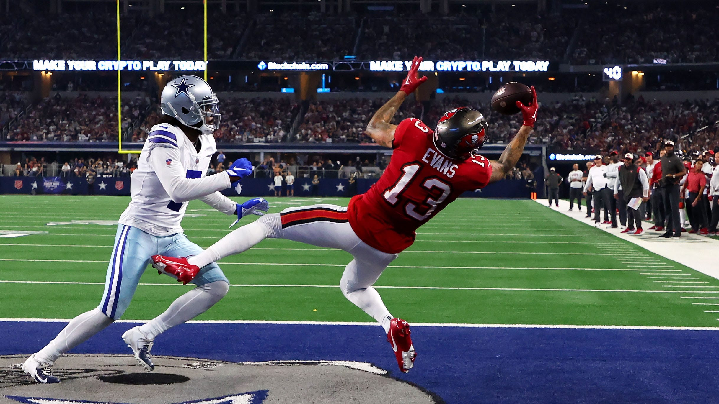
Utilizing Machine Learning to Predict NFL Game Results
Brendan Schneider
Notes:
- I wanted to build a data model about sports
- It's American football season, so I looked at NFL game data

Slide 2
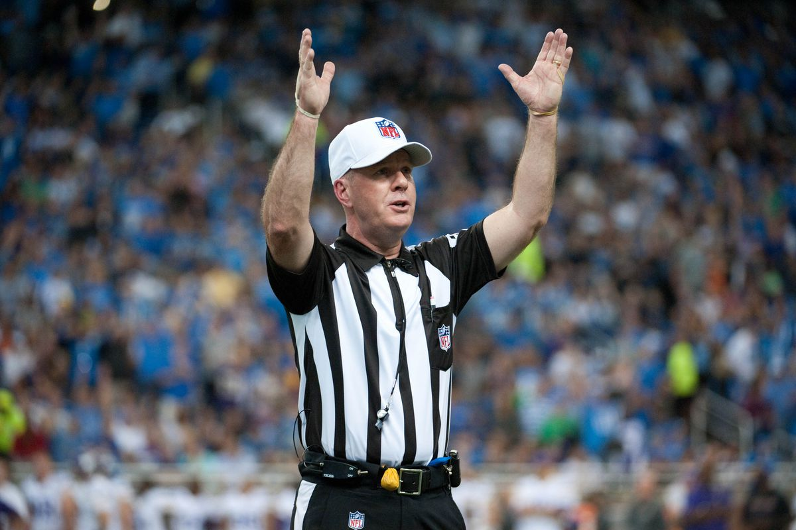
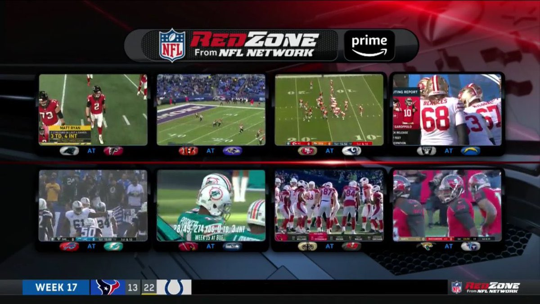
Questions
What predictions can we make about NFL games?
Can we predict the winner? The final score? The spread?
How accurately?
What data is available to us for answering these questions?
Notes:
- How accurately could I model upcoming games?
- Could I model the winner? What about the final score? Or the point spread?

Slide 3
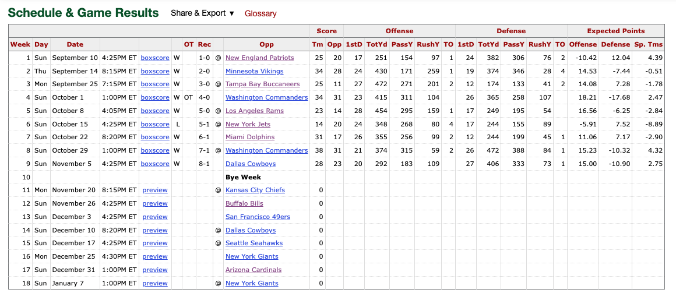
Web Scraping
Pro Football Reference has game statistics for each team
Notes:
- I got team-level game data from Pro Football Reference
- The most important statistics here are the points scored, points allowed, and game result

Slide 4
Web Scraping
Matthew Kim built a project to scrape data from Pro Football Reference
I leveraged his team_game_log.py file to collect this data myself, pulling additional statistics and enabling it to work for the current season
Scraping 16 teams at a time avoided a Too Many Requests error
Assumption: regular season data since 2010 is enough for noteworthy findings
Notes:
- I used a web scraper in Python that utilized BeautifulSoup
- Pulled regular season game data for every team since the 2010 season

Slide 5

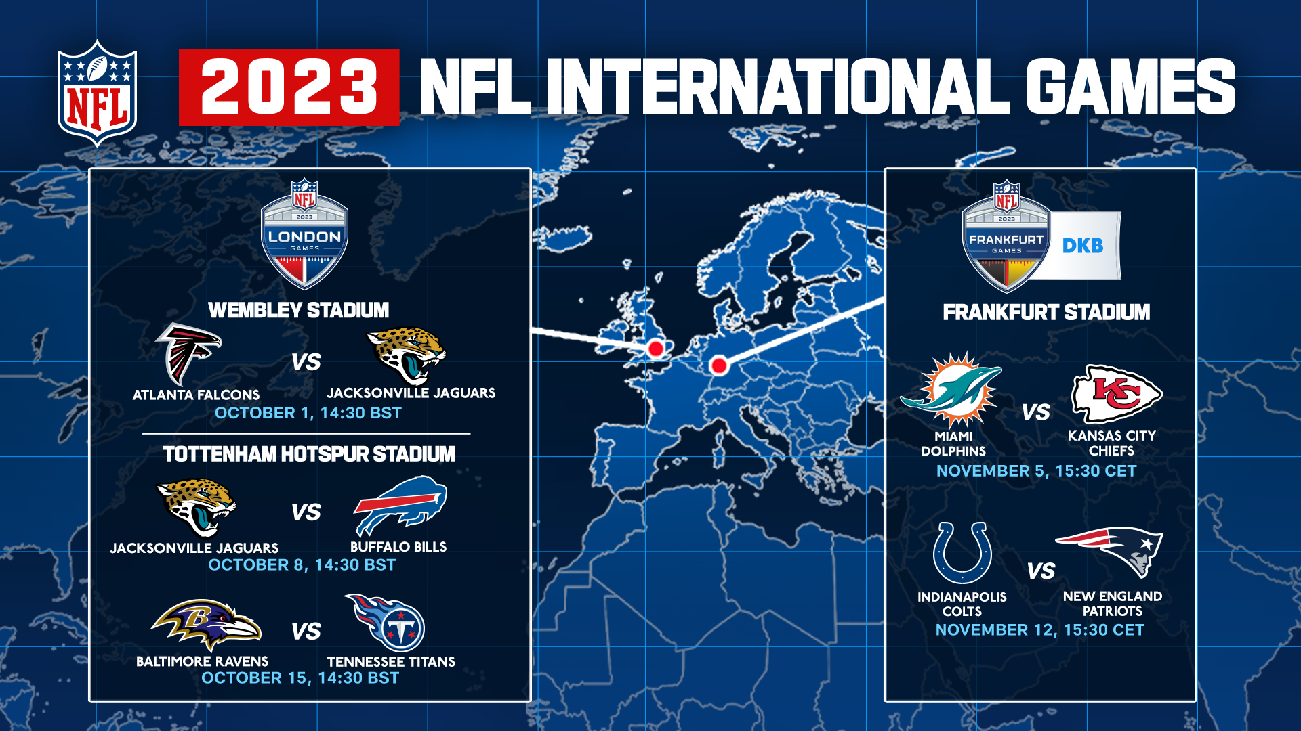
Data Cleansing
Not all franchises used the same name
Not every franchises had the same home stadium
Some games were played at a neutral location
Notes:
- Cleaned up franchise names
- I thought to incorporate travel distance, so tracking stadiums and neutral sites was important

Slide 6
Feature Engineering – Average Stats
Making predictions for a game before it is played means we’ll need to utilize data from previous games
Created columns for average values of statistics for each team over the past 1-8 games
Averages include stats for the offense and defense of each team, as well as their opponent for that week
Notes:
- I wanted to model upcoming games based on data from previous games
- Created features that averaged statistics for the past X number of games, from 1 to 8

Slide 7
Elo Rating System
Arpad Elo created a system to assign values to chess players to rate their skill; this system can be applied to other games
Elo ratings factors in quality of the competitor, as opposed to pure numerical statistics in the game
Defeating opponents with high Elo ratings and by large margins increases a team’s Elo score greatly, and vice versa
Analysis begins in 2012, letting Elo settle
Notes:
- Elo is the key feature in this project
- Developed for chess originally, it's used in sports, online gaming, and other competitions
- NFL teams start at the average value of 1500; it increases with wins, and decreases with losses; zero-sum
- The change in Elo is also dependent on the margin of victory and difference in Elo scores
- Modelling begins in 2012 so Elo scores have two years of data to settle

Slide 8
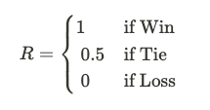
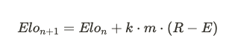
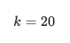
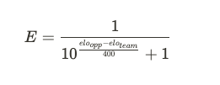
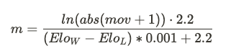
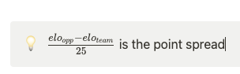
Elo Rating System
Formulas from a UPenn student project and FiveThirtyEight
Each team begins at 1500
Notes:
- Essentially, Elo after a game equals the Elo before plus the change
- k-factor is sensitivity (too high is reactionary, too low isn't effective)
- Margin of Victory multiplier depends on point spread
- R and E factor in expected win rate

Slide 9
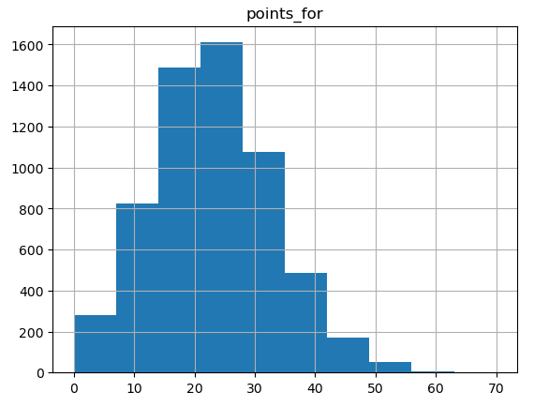
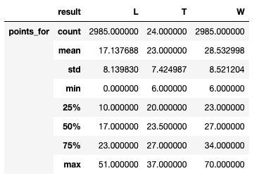
Exploratory Data Analysis
Descriptions of Points Scored by game outcome
Notes:
- Points scored seems to follow a normal distribution when bucketed

Slide 10
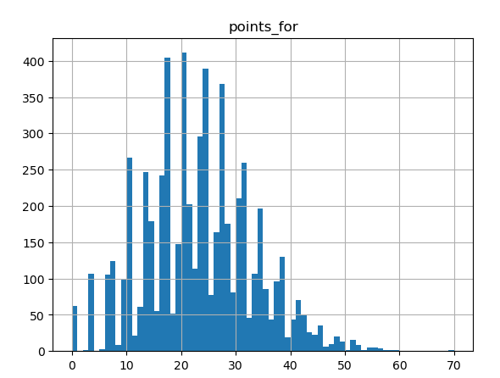
Exploratory Data Analysis
Some scores are more common than others
Notes:
- Seeing points scored per value shows the quirks of NFL scoring (7's and 3's)

Slide 11
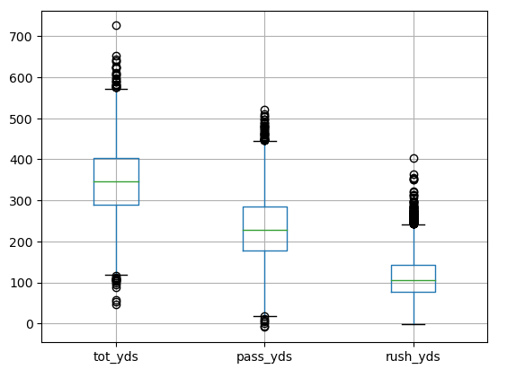
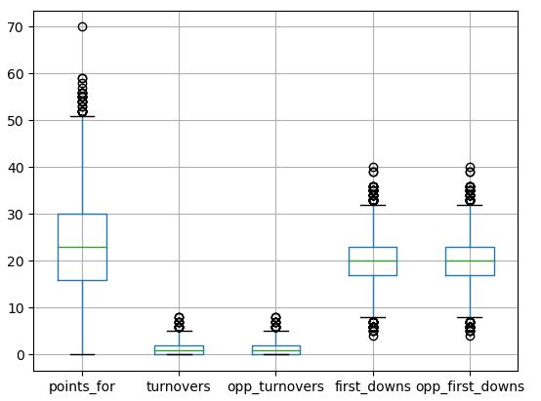
Exploratory Data Analysis
Notes:
SKIP

Slide 12
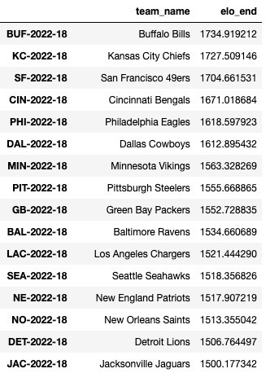
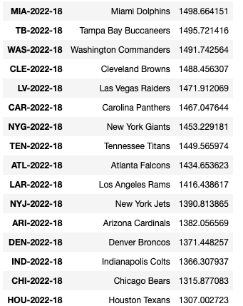
Exploratory Data Analysis
Notes:
Elo ratings at the end of the 2022 season seem in line with team success

Slide 13
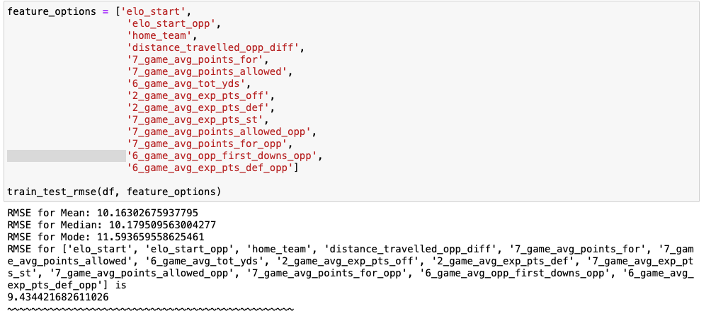
Can a Linear Regression Predict Points Scored?
The RMSE for the mean was 10.16 points (per team)
The best RMSE I could find was 9.43 points (per team)
The average margin of victory was 11.35 (total)
Notes:
Linear regression did not create a useful estimation of points scored

Slide 14
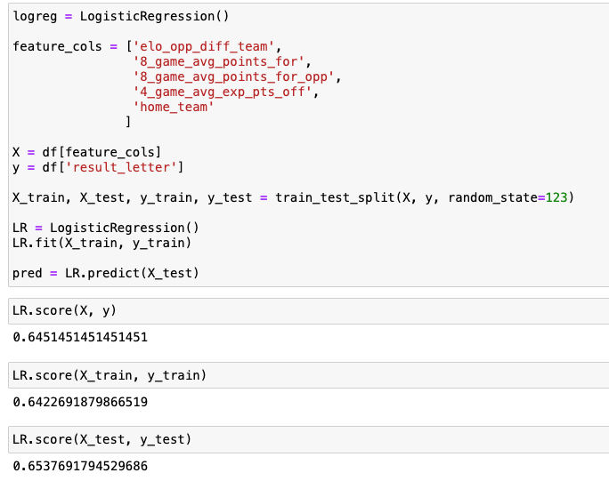
Can a Logistic Regression Predict the Winner of an NFL game?
The best accuracy I could get was 65.38%
Compare to the 55% win rate of home teams
Picking the favorite according to this Elo rating each game has an accuracy of 63.6%
Notes:
Logistic Regression got to 65%
Null Model is a coin flip; home teams win 55% of the time
Higher Elo value wins 63%

Slide 15
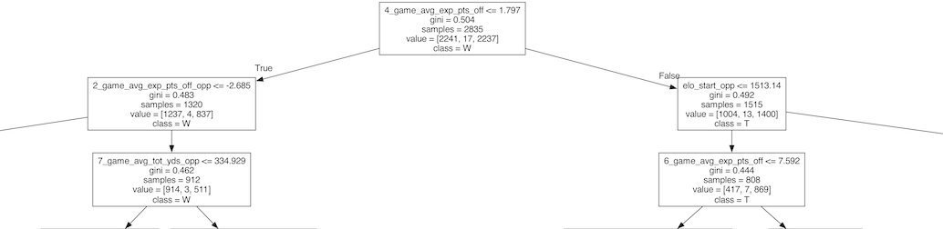
Can a Random Forest Predict the Winner of an NFL Game
Using a Random Forest Classifier, we were able to correctly model 65.58% of games
The beginning of Tree #7 in the Random Forest
Notes:
65% again using Random Forest

Slide 16
How Did We Do?
Modelling points scored was too variable to predict values
Logistic Regression and Random Forest got us to around 65% accuracy
This is about 10% more games correctly picked than picking the home team, and just a bit better than picking the favorite according to Elo
Compare to experts at ESPN, NFL, CBS, Pickwatch and other cites, it’s on par with the best experts
Notes:
There are a lot of variables in an NFL game
65% accuracy seems comparable to the best picks from networks

Slide 17
Areas for Improvement
Fix collinearity between Elo features and window features
Look for advanced metrics
Try exponentially weighting recent games instead of averaging previous games equally
Improve Elo calculation (FiveThirtyEight considers home field, rest days, and quarterbacks)
Incorporate player-level data
Notes:
- Want to use more stats more effectively
- Account for collinearity between the averages
- Use exponential weights instead of pure averages
- Improve Elo calculation with home field advantage, rest days, and quarterback play
- Incorporate player data

Slide 18
Bibliography
Matthew Kim
https://pypi.org/project/pro-football-reference-web-scraper/
https://pypi.org/user/mjk9/
https://github.com/mjk2244/pro-football-reference-web-scraper
Josh Weiner
https://towardsdatascience.com/predicting-the-outcome-of-nba-games-with-machine-learning-a810bb768f20
https://github.com/JoshWeiner/NBA_Game_Prediction

Slide 19
Bibliography (Cont.)
FiveThirtyEight
https://fivethirtyeight.com/methodology/how-our-nfl-predictions-work/
Pro Football Reference
https://www.pro-football-reference.com/
Open Source Football
https://opensourcefootball.com/posts/2021-01-21-nfl-game-prediction-using-logistic-regression/
Will Koehrsen
https://towardsdatascience.com/how-to-visualize-a-decision-tree-from-a-random-forest-in-python-using-scikit-learn-38ad2d75f21c
Wikipedia
https://en.wikipedia.org/wiki/Chronology_of_home_stadiums_for_current_National_Football_League_teams
Google Images

